Slide 1
Azure Virtual Desktop (AVD) IaC Demo
AVD 2nd Spoke Landing Zone
End-to-End Enterprise Architecture, FSLogix Profiles, MSIX App Attach & Azure Compute Gallery Automation
git clone https://github.com/sam6shk/AVD_IaC_Spoke_Demo.git

Slide 2
Requirement & Scope
Why a dedicated AVD 2nd Spoke Virtual Network?
Architecture Context
Business Expectations
Key Architectural Solutions
▹Second Spoke VNet: Connects seamlessly to Hub.
▹Bi-directional Peering with Hub VNet (`10.2.0.0/16`).
▹100% Terraform IaC: Zero manual portal clickops.
▹Forced Tunneling UDR routing egress via Hub Firewall.
▹Automated Image System: Versioning without rebuilds.
▹Azure Compute Gallery for structured versioning.
▹FSLogix & MSIX: High performance profile & app delivery.
▹Private Endpoints securing storage backends.

Slide 3
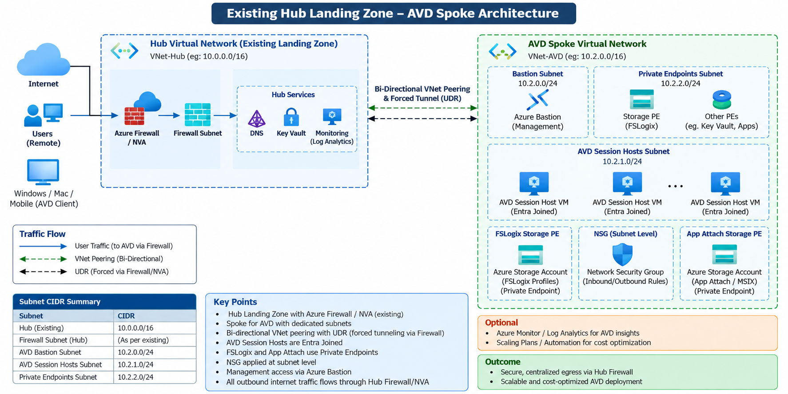
High-Level Architecture (HLD)
Hub-and-Spoke Topology & Network Flow

Slide 4
Simplified Host Pool Image Update
Azure Compute Gallery (SIG) Rolling Updates
Image Lifecycle
1. Build & Version
2. Update Terraform
3. Zero-Downtime Rollout
▹Golden Image stored in Compute Gallery.
▹Set `use_custom_gallery_image = true`.
▹Enable Drain Mode on existing session hosts.
▹Win11 Multi-Session + M365 base definition.
▹Pass new version ID in `terraform.tfvars`.
▹Provision new host VMs from new image.
▹Structured semantic versioning (`v1.0.1`).
▹No host pool control plane recreation needed.
▹Gracefully retire old hosts post-logoff.

Slide 5
Profile Management with FSLogix
Premium Azure Files & Automated Provisioning
Storage & Profiles
Storage Architecture
▹Premium FileStorage with ZRS replication.
Automated Script Injection
▹Secured via Private Endpoint in Spoke VNet.
New-Item -Path 'HKLM:\SOFTWARE\FSLogix\Profiles' -Force New-ItemProperty -Name 'Enabled' -Value 1 -PropertyType DWORD New-ItemProperty -Name 'VHDLocations' -Value '\\stfslogix...file.core.windows.net\profiles' New-ItemProperty -Name 'SizeInMB' -Value 30000
▹Public network access completely disabled.
▹Supports Entra ID Kerberos SMB auth.

Slide 6
Dynamic App Delivery (MSIX App Attach)
Decoupling Applications from the OS Image
App Attach
Package Storage Setup
Key Benefits
▹Dedicated Storage Account (`stappattach...`).
▹70% Faster OS Patching: Base image stays clean.
▹Secured via dedicated Private Endpoint in Spoke VNet.
▹Zero App Conflicts: Isolated container execution.
▹Stores `.vhdx` / `.cim` application container packages.
▹On-Demand Mounting upon user sign-in.

Slide 7
Security & Governance Controls
Enterprise Security Posture
Security
🛡️ Forced Tunneling
🔒 Private Link Only
🆔 Entra ID Identity
UDR on Session Host subnet routes all internet egress (`0.0.0.0/0`) through Hub NVA / Firewall for deep inspection.
Storage accounts for FSLogix & App Attach completely block public IP ingress, enforcing secure private access.
Session Hosts natively joined to Microsoft Entra ID via `AADLoginForWindows` extension with RBAC controls.

Slide 8
Terraform Code Structure
Modular HCL Architecture
IaC Modules
Network & Storage Modules
Core & Host Modules
▹`network.tf` - VNet, Subnets, UDR, NSG, Peering
▹`avd_core.tf` - Workspace, Host Pool, DAG
▹`compute_gallery.tf` - Shared Image Gallery & Def
▹`avd_session_hosts.tf` - Session Hosts & Extensions
▹`storage_fslogix.tf` - FSLogix Storage & PE
▹`outputs.tf` - Resource IDs & UNC paths
▹`storage_appattach.tf` - App Attach Storage & PE
▹`terraform.tfvars.example` - Config inputs

Slide 9
Demo Execution & Verification
Commands & GitHub Repository
Live Demo
Terraform Execution
Validation Result
Success! Configuration is valid.
git clone https://github.com/sam6shk/AVD_IaC_Spoke_Demo.git cd AVD_IaC_Spoke_Demo terraform init terraform plan -out=tfplan terraform apply tfplan
▹0 Errors & 0 Warnings detected.
▹Formatted cleanly with `terraform fmt`.
▹Pushed to GitHub repository successfully.

Slide 10
Operational Readiness
Summary & Next Steps
Fully automated 2nd Spoke AVD Landing Zone deployment with decoupled SIG, FSLogix & App Attach.
🌟 Key Achievements
🚀 Rollout Checklist
Production-grade security, forced tunneling, and zero-clickops Terraform modularity.
Integrate CI/CD pipelines, configure autoscaling plans, and upload custom MSIX packages.

